Slide 1
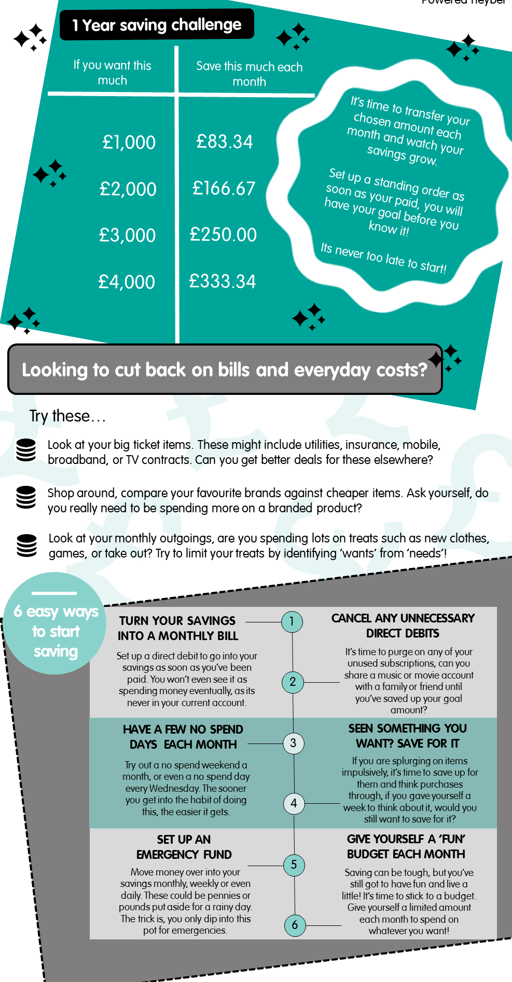
TYPE URL HERE

